Slide 1
Kernels

Slide 2
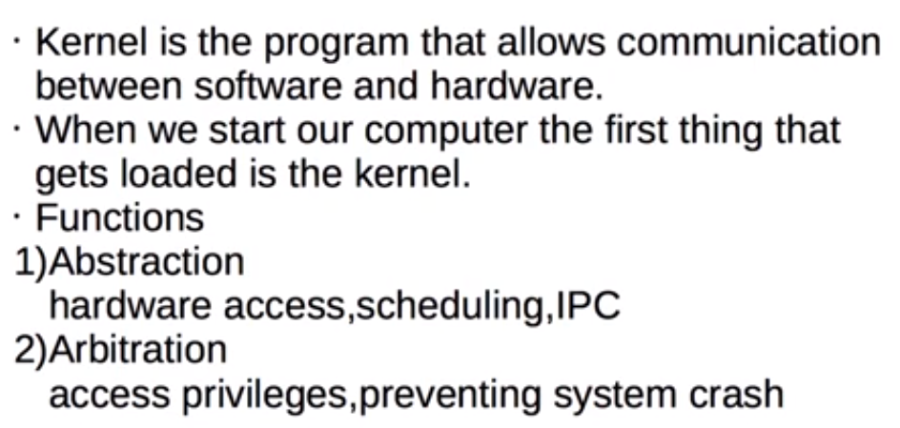
Kernels

Slide 3
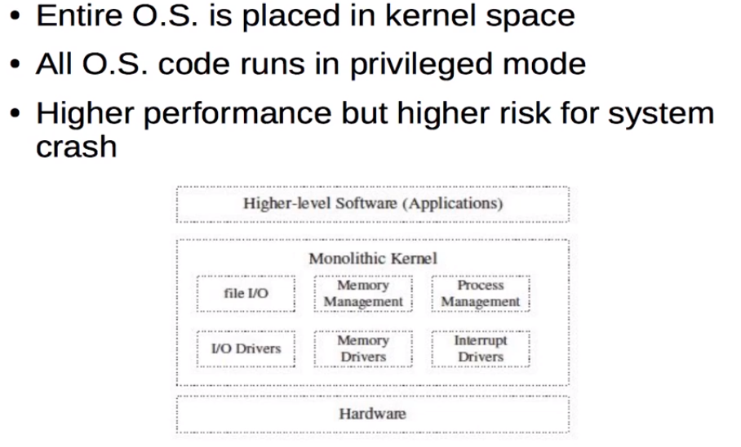
Monolithic Kernel

Slide 4
Monolithic Kernel
All OS related components stuffed as in single module in kernel space.
If one service crashes then the whole OS crashes.
It is larger in size but fast in execution.
These services are difficult to debug.
If user want to add new service then need to modify entire OS.
If any security issue generated then it corrupt the whole kernel.
Ex:- Linux,DOS,Solaris.

Slide 5
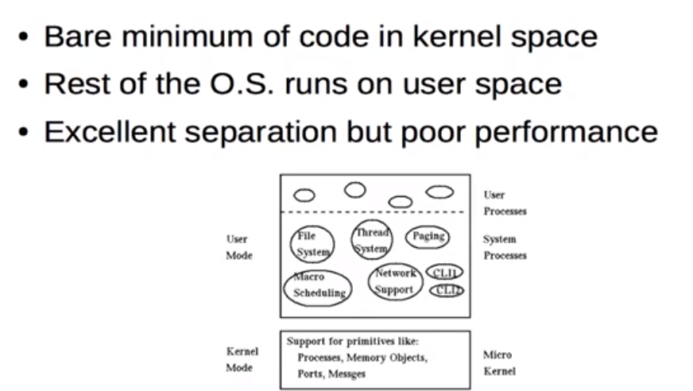
Micro-lithic Kernel

Slide 6
Micro-lithic Kernel
In this kernel, all non-essential components are moved from kernel space to user space.
Only essential components like IPC,M/M management are including in kernel space.
If services fails, rest OS works in kernel space.
Smaller in size but slow in execution.
Debugging is easy and new services will added.
Ex:- Mac Os ,Windows NT.

Slide 7
Hybrid Kernel
A Hybrid Kernel is a combination of both Monolithic Kernel and Microkernel. It makes the use of the speed of Monolithic Kernel and the modularity of Microkernel.
Hybrid kernels are micro kernels that have some "non-essential" code in kernel-space in order for the code to run more quickly than it would be in user-space. So, some services such as network stack or filesystem are run in Kernel space to reduce the performance overhead, but still, it runs kernel code as servers in the user-space.

Slide 8
Nano-kernel
In a Nano-krnel, as the name suggests, the whole code of the kernel is very small i.e. the code executing in the privileged mode of the hardware is very small. The term nano-kernel is used to describe a kernel that supports a nanosecond clock resolution.

Slide 9
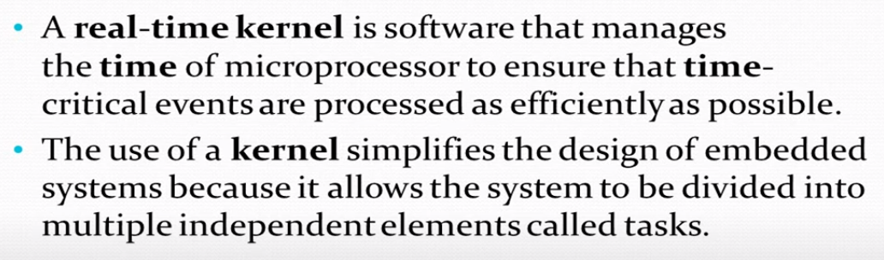
Real time kernel

Slide 10
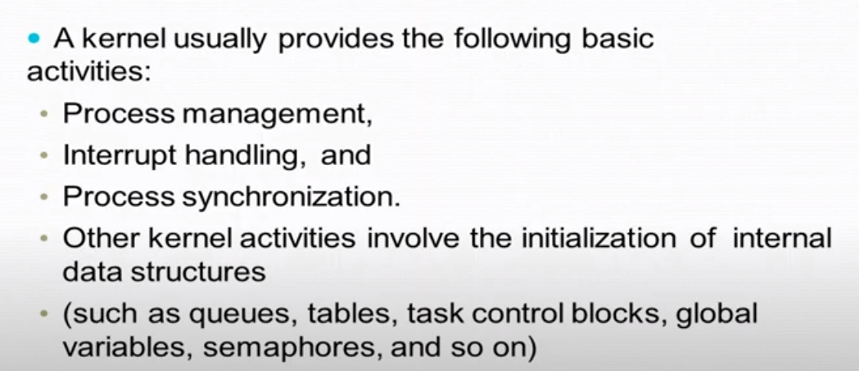
Real Time Kernel

Slide 11
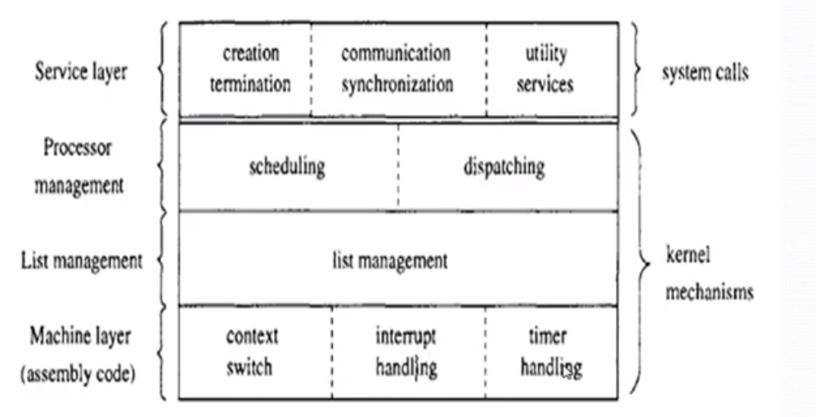
Real Time Kernel

Slide 12
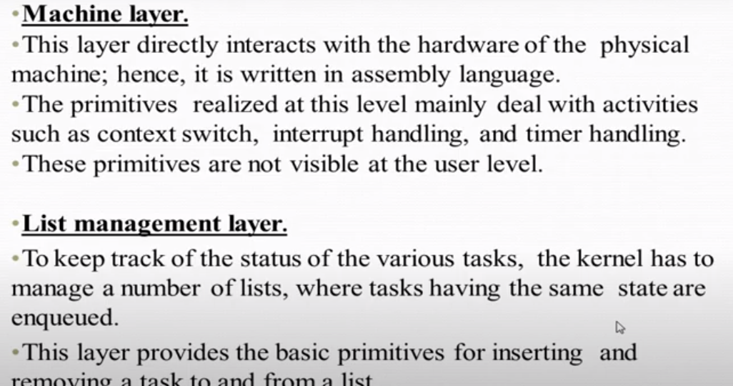
Real time kernel

Slide 13
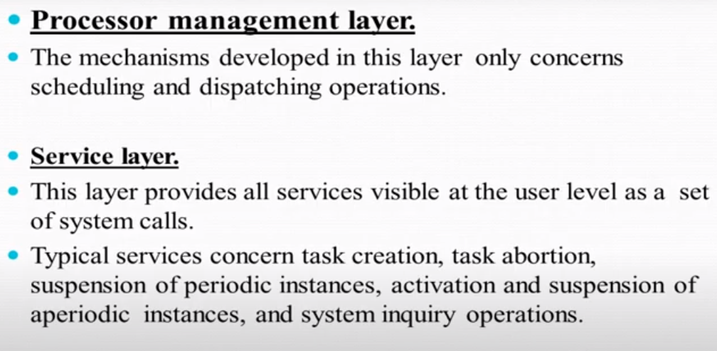
Real time Kernel

Slide 14
Exo-kernel
Exokernel is a type of operating system developed at the Massachusetts Institute of Technology that seeks to provide application-level management of hardware resources. The exokernel architecture is designed to separate resource protection from management to facilitate application-specific customization.
They are extremely small.
Functionality is limited.

Slide 15
Exo-kernel
Conventional operating systems always have an impact on the performance, functionality and scope of applications that are built on them because the OS is positioned between the applications and the physical hardware. The exokernel operating system attempts to address this problem by eliminating the notion that an operating system must provide abstractions upon which to build applications. The idea is to impose as few abstractions as possible on the developers and to provide them with the liberty to use abstractions as and when needed.
The exo-kernel architecture is built such that a small kernel moves all hardware abstractions into un-trusted libraries known as library operating systems.
The main goal of an exo-kernel is to ensure that there is no forced abstraction, which is what makes an exo-kernel different from micro- and monolithic kernels.

Slide 16
EXO-kernel
The benefits of the exokernel operating system include:
Improved performance of applications
More efficient use of hardware resources through precise resource allocation and revocation
Easier development and testing of new operating systems
Each user-space application is allowed to apply its own optimized memory management

Slide 17
Re-ENTERENT Kernel
If the kernel is not re-entrant, a process can only be suspended while it is in user mode. Although it could be suspended in kernel mode, that would still block kernel mode execution on all other processes. The reason for this is that all kernel threads share the same memory. If execution would jump between them arbitrarily, corruption might occur.
A re-entrant kernel enables processes (or, to be more precise, their corresponding kernel threads) to give away the CPU while in kernel mode. They do not hinder other processes from also entering kernel mode. A typical use case is IO wait. The process wants to read a file. It calls a kernel function for this. Inside the kernel function, the disk controller is asked for the data. Getting the data will take some time and the function is blocked during that time. With a re-entrant kernel, the scheduler will assign the CPU to another process (kernel thread) until an interrupt from the disk controller indicates that the data is available and our thread can be resumed. This process can still access IO (which needs kernel functions), like user input. The system stays responsive and CPU time waste due to IO wait is reduced.

